Slide 1
Smart donor
T.SAI CHARAN (18B81A1288) GUIDED BY:
P.SAI CHARAN REDDY (18B81A1289) D. BHANU MAHESH
P.YASHWANTH REDDY(18B81A12B9)
BATCH-15

Slide 2
Abstract
Smart Donor is a website , that acts a bridge between an organ donor and a patient who needs them.
Smart Donor is a platform that finds donors from across the nation , verifies their health background by a team of specialized team of doctors and then these donors details are made online.
When a patient who needs an organ visits our website can have access from a wide range of donors who are willing to donate their organs. This process makes patients to find their needs in a fast and easy manner.
Smart Donor also have connections with all the hospitals and the state governments to donate organs who all need them.

Slide 3
introduction
Technology in the world is improving at a faster rate which any of us has ever assumed. In this world, every work will be automated in the near future. Siting at our comfort place we can get anything we want to us write from our mobile. So why can we do this in the most necessary health sector by any common man? So as a part of this, we want to develop a fully functional website, SMART DONOR, that allows any person from any corner of India to donate organs as well as any person who needs one. Not only that SMART DONOR has connections with every local hospital that makes it easy for the public to donate and to make a request for any organ.

Slide 4
Literature review and limitations of the existing works
Limitations of the existing works :
https://www.apollohospitals.com/organ-donation/
https://www.organdonor.gov/register.html
All of the existing websites only accept donors to get registered online. But any of the websites don't have a platform to connect donors and patients from across the nation.
Literature Review :
We have contacted a nearest hospitals and came to know that society has almost zero knowledge about organ donation, also even if they know they don’t have a clear idea how the process can be done.

Slide 5
Software requirement specification
Functional requirements
Authentication of the user whenever he/she logs in to the system.
Verifies user whenever he/she donates an organ.
Verifies user whenever he/she requests for an organ.
Non-Functional requirements
Any request placed by registered user should be verified within 24 hrs.
In case of emergency of an organ user can request for an organ while verification will be under process. If at any point of time user verification fails he/she can not move forward with the same request and need to place a new request.

Slide 6
Problem statement & description
17 people die every day waiting for an organ transplant
107,000+ Number of men, women, and children on the national transplant waiting list as of February 2021.
Every 9 minutes another person is added to the transplant waiting list.
Watching the above stats we can assume how much there is a need for organ donation in the world. To make this work easy we have come up with an easy way to develop a website that connects donors and patients from any part of India.

Slide 7
Motivation and scope
Motivation:
After seeing the number of deaths and people waiting for organ donation we want to make organ donation much easier and also anyone can find their required organ easily.
Scope:
Can be accessible across India.
This website can be developed to meet international standards and can be used by different countries.

Slide 8
modules
Home Page
Registration and login pages
Registration Page
Login Page
User operations
Donor
Patient
Profile
DataBase Connection Modules
New User Registration
Registered User Login
Donation from User
Organ Request from User
Presenting Active Requests on Home Page

Slide 9
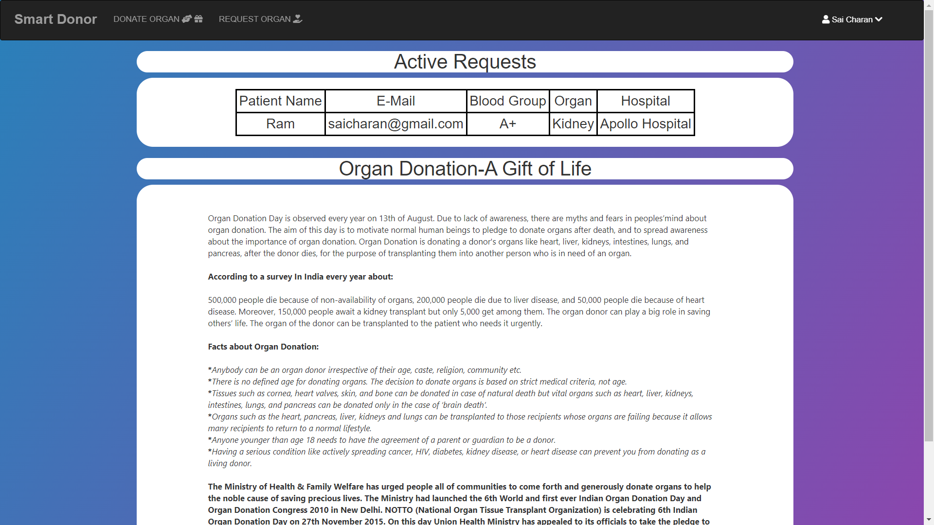
HOME PAGE

Slide 10
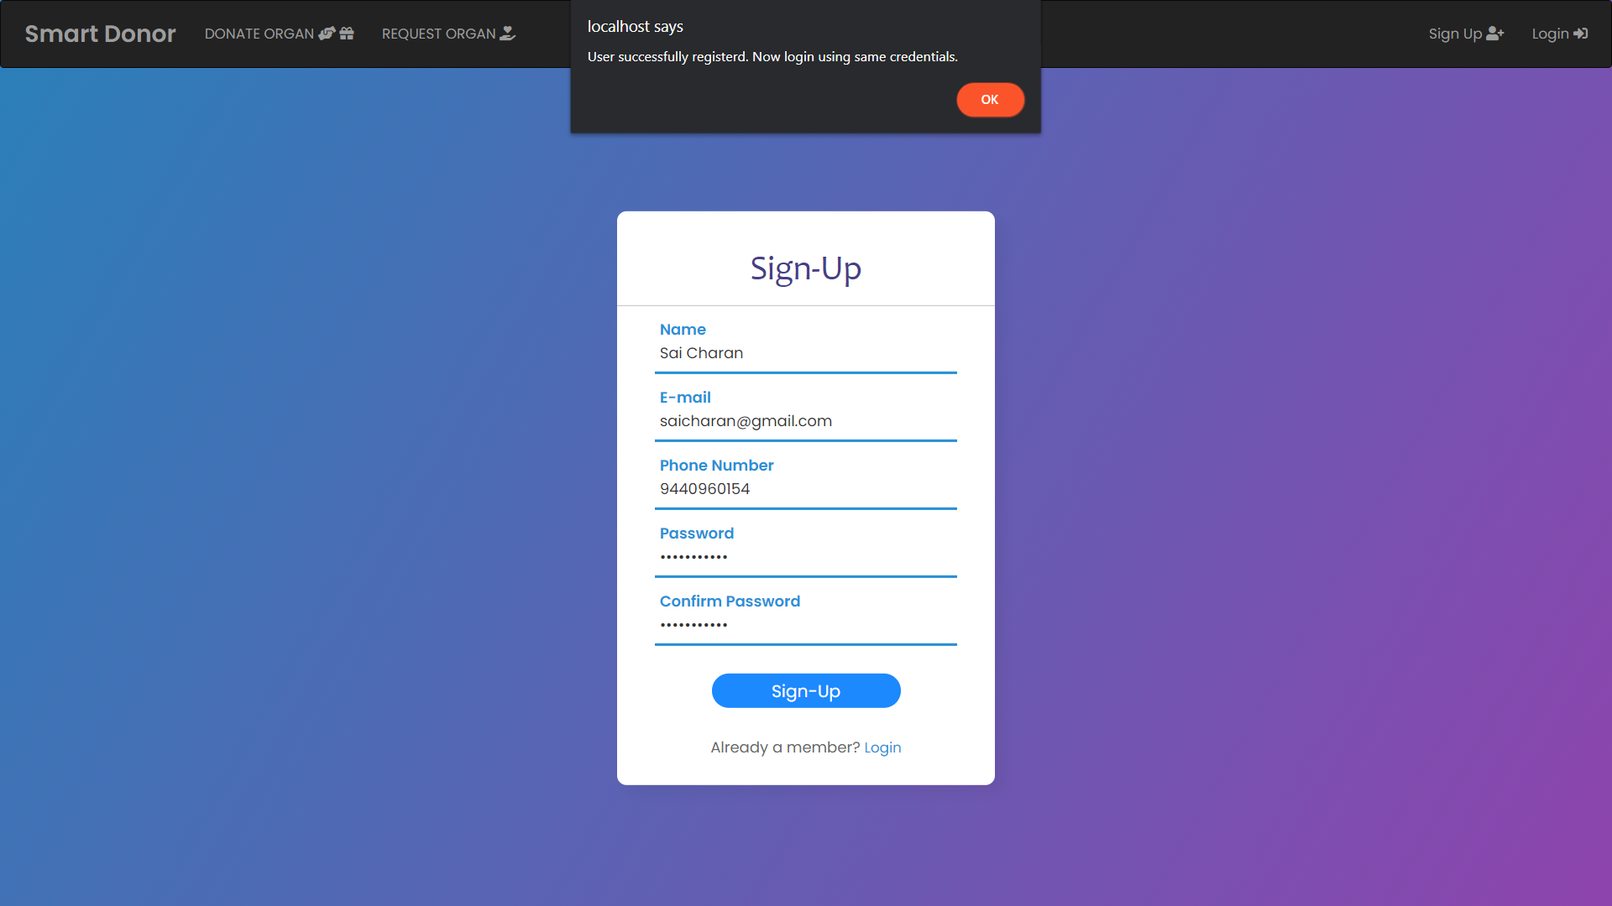
USER REGISTRATION PAGE

Slide 11
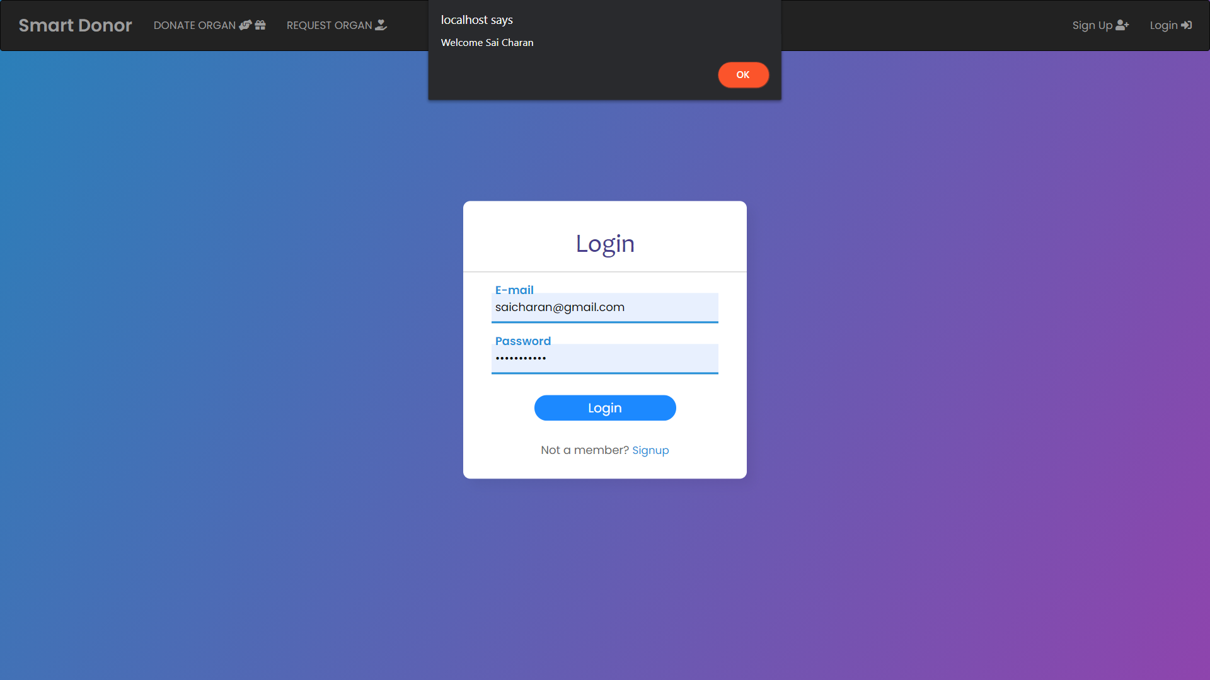
User login page

Slide 12
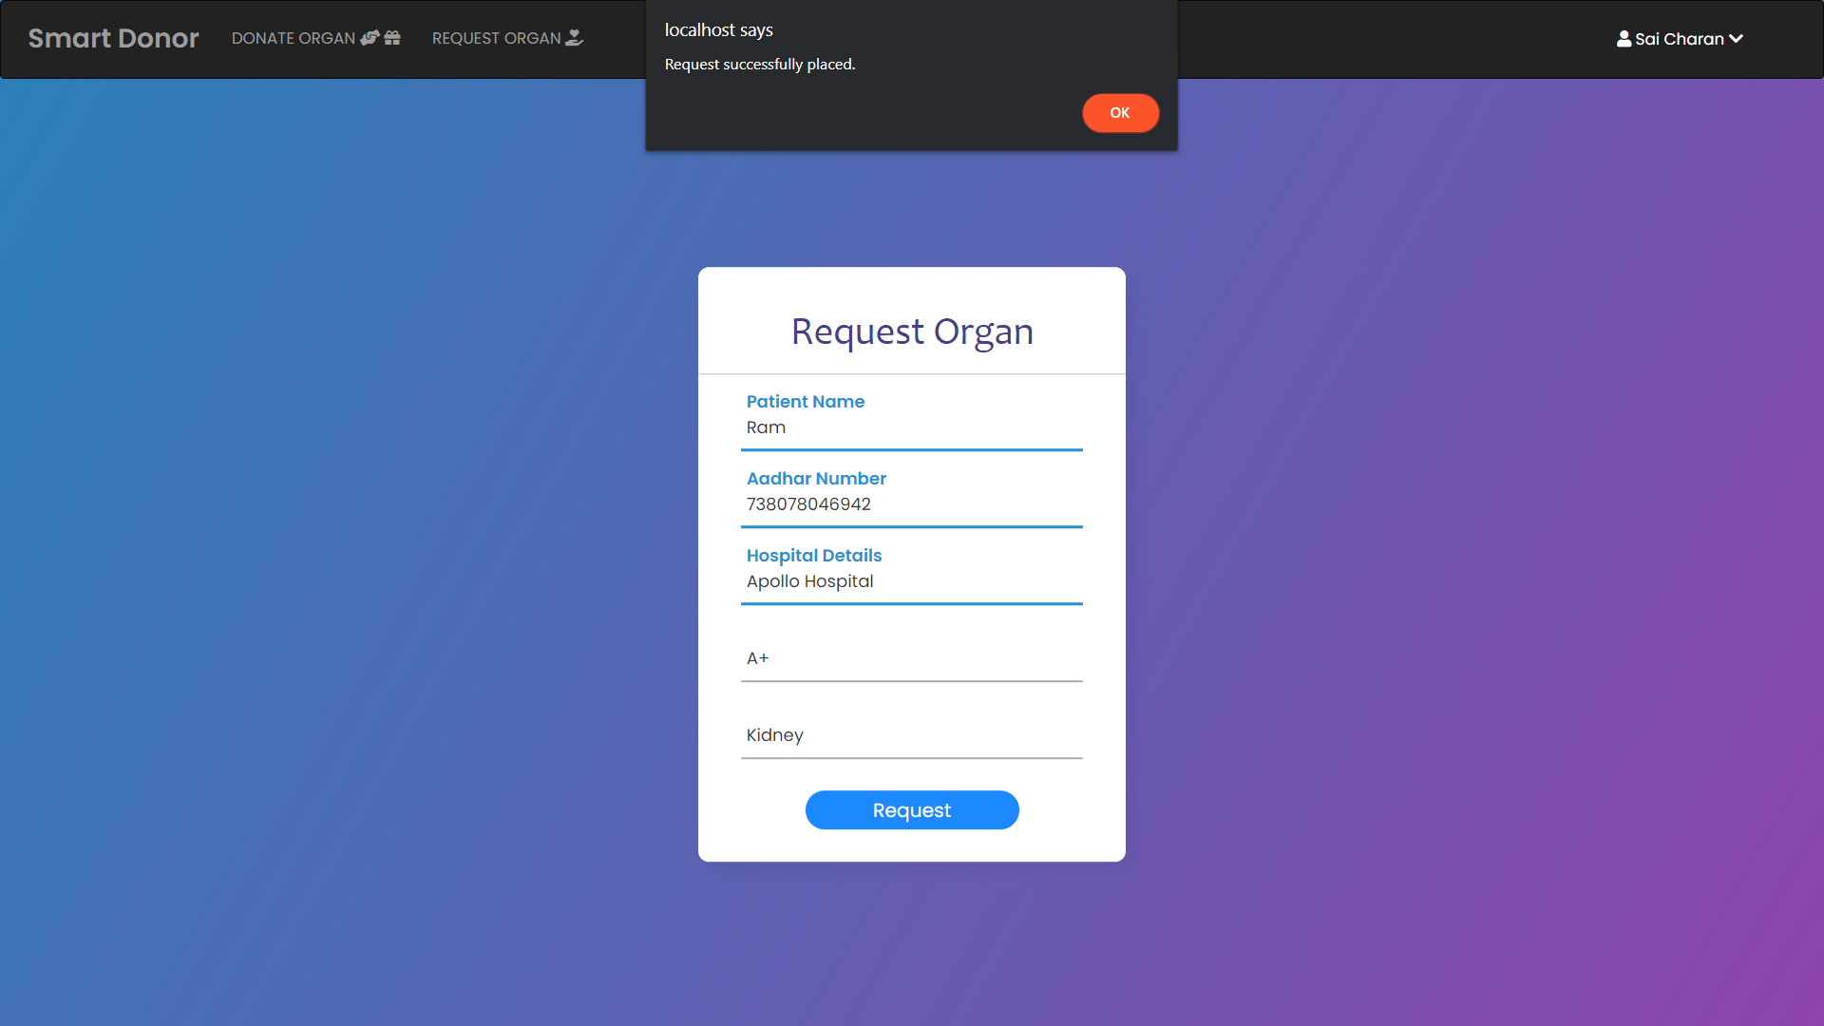
ORGAN REQUESTING PAGE

Slide 13
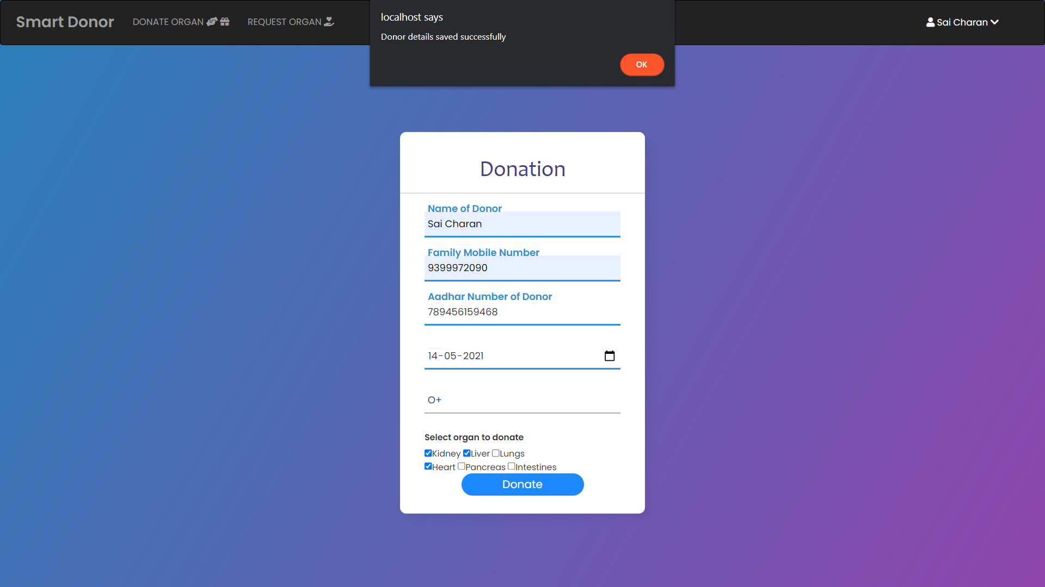
ORGAN DONATION PAGE

Slide 14
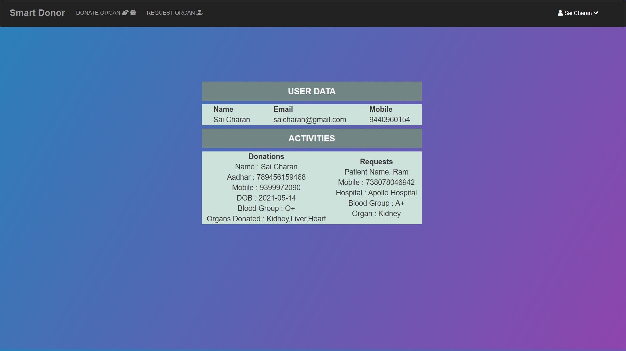
USER PROFILE PAGE

Slide 15
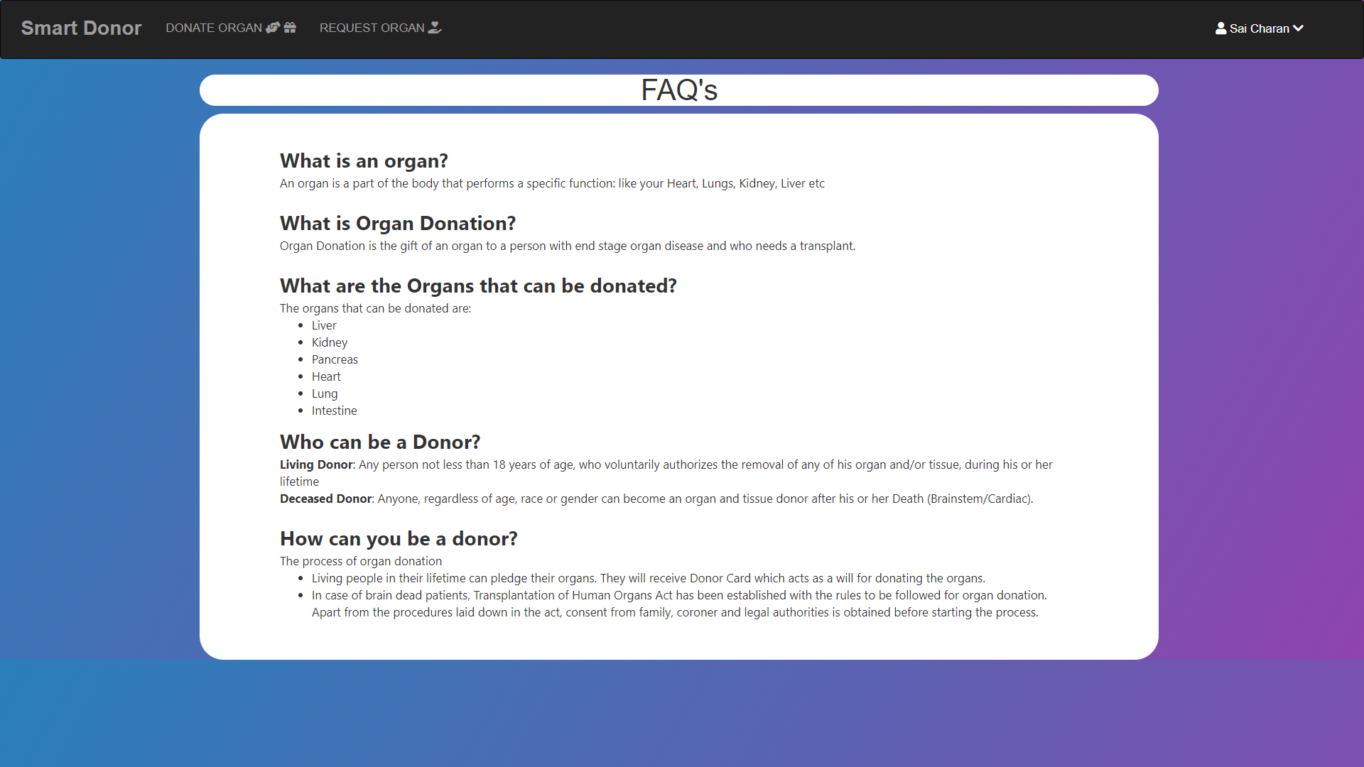
Faq’s PAGE

Slide 16
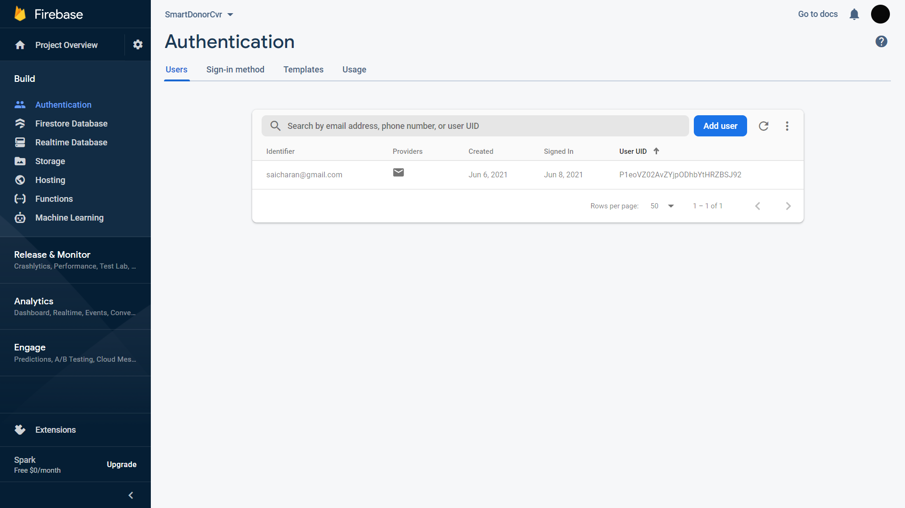

Slide 17
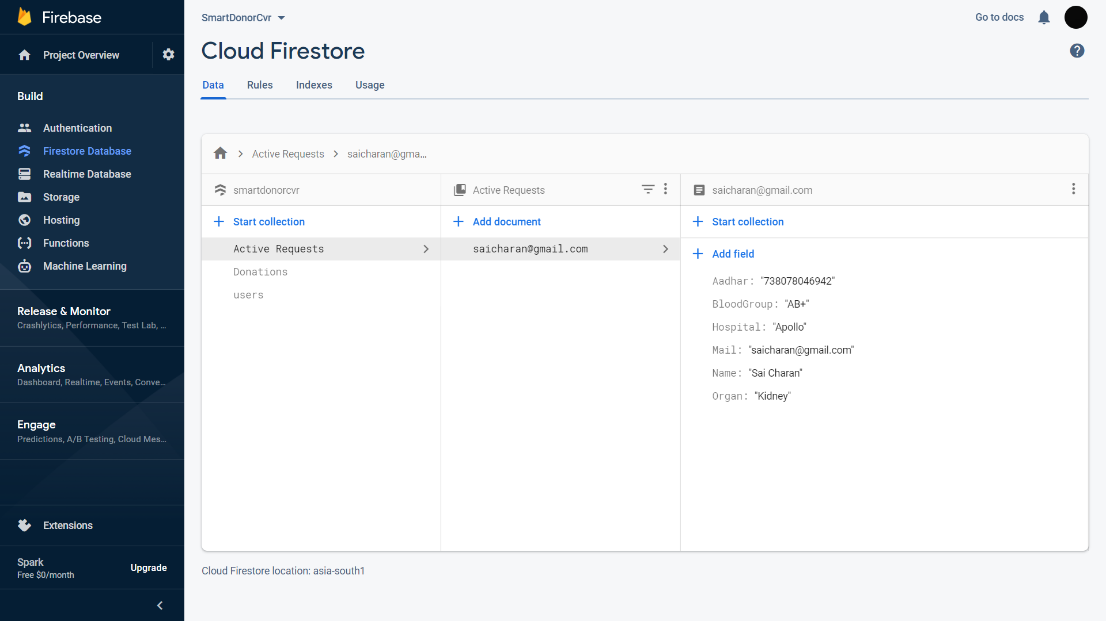

Slide 18
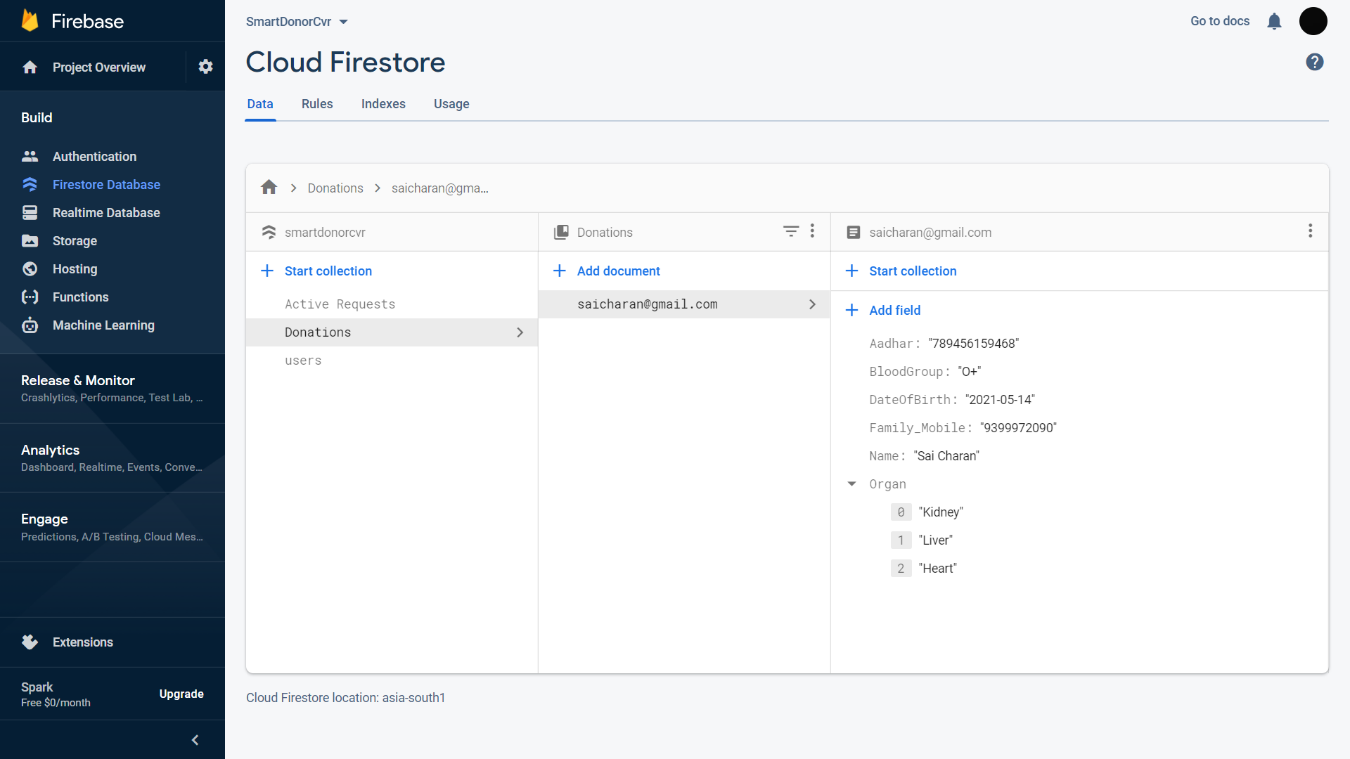

Slide 19
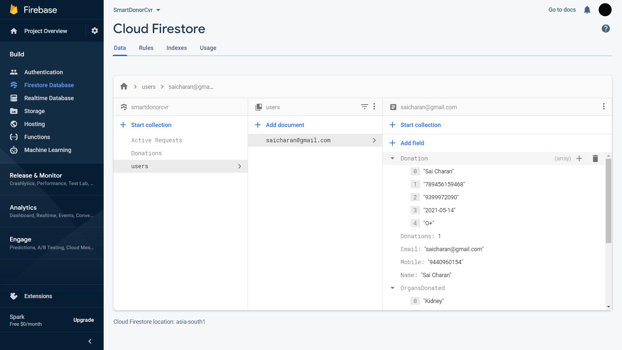

Slide 20
Minimum configuration [hardware & software]
Hardware Requirements :
Processor intel i3(min configuration)
RAM 4GB or more
Software Requirements :
HTML5 , CSS , BOOTSTRAP
JAVASCRIPT , JQUERY
FIREBASE FIRESTORE
PHP

Slide 21
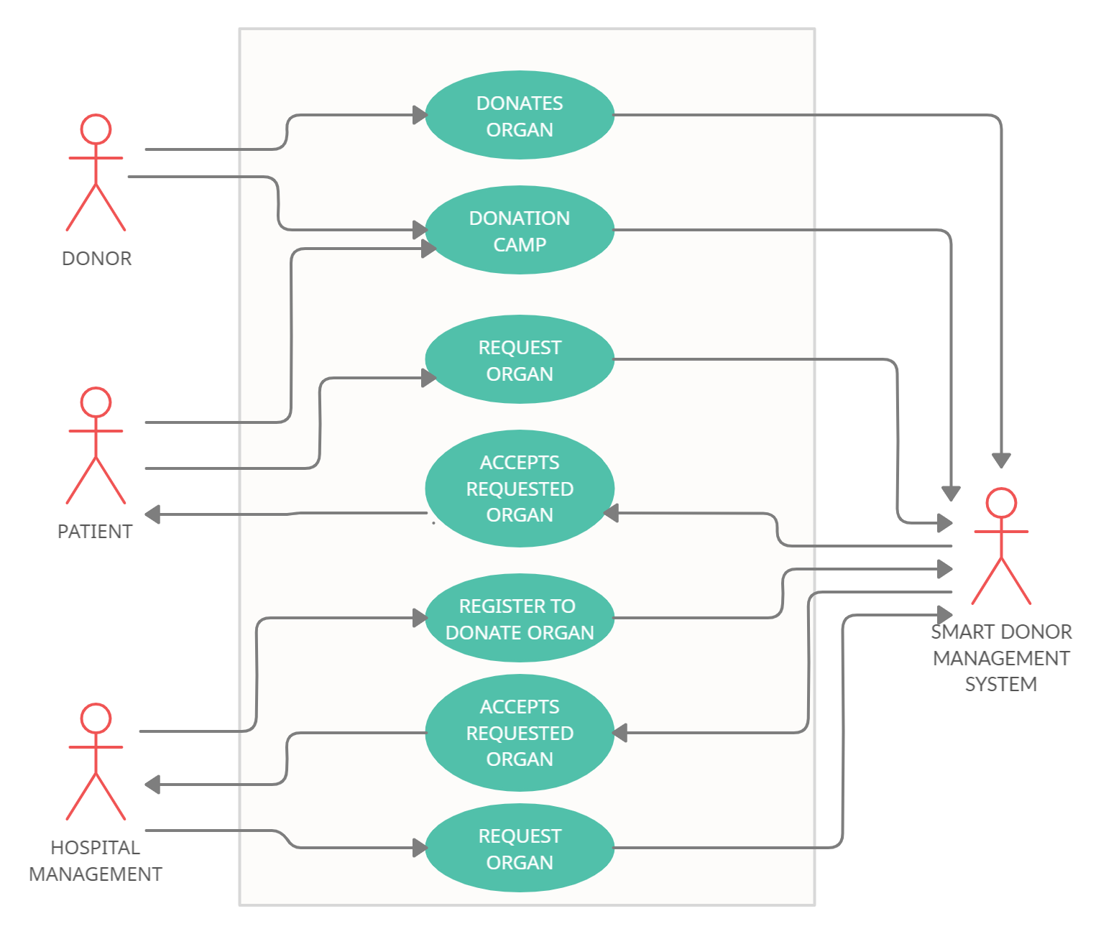
Use case diagram

Slide 22
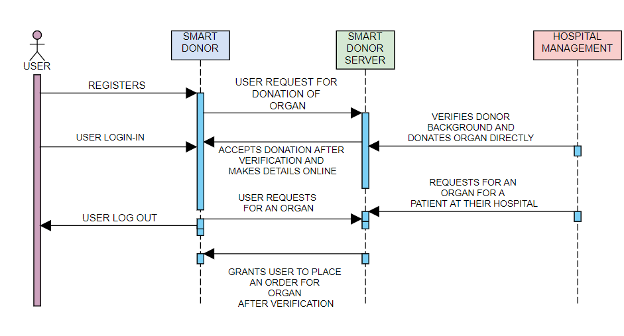
Sequence diagram

Slide 23
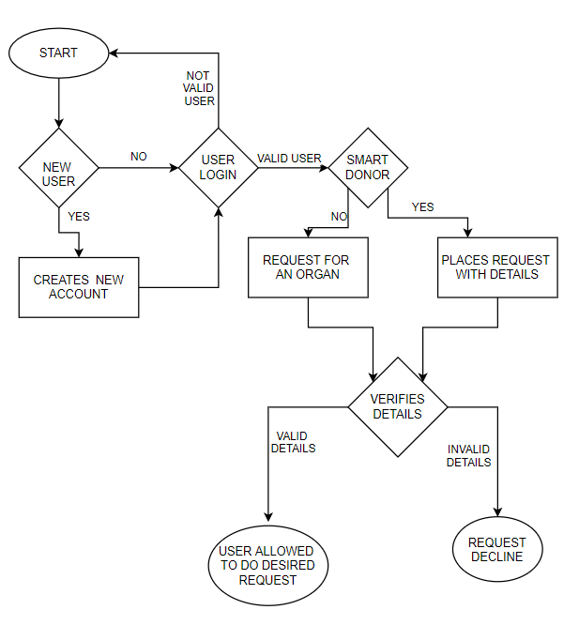
ARCHITECTURAL DIAGRAM

Slide 24
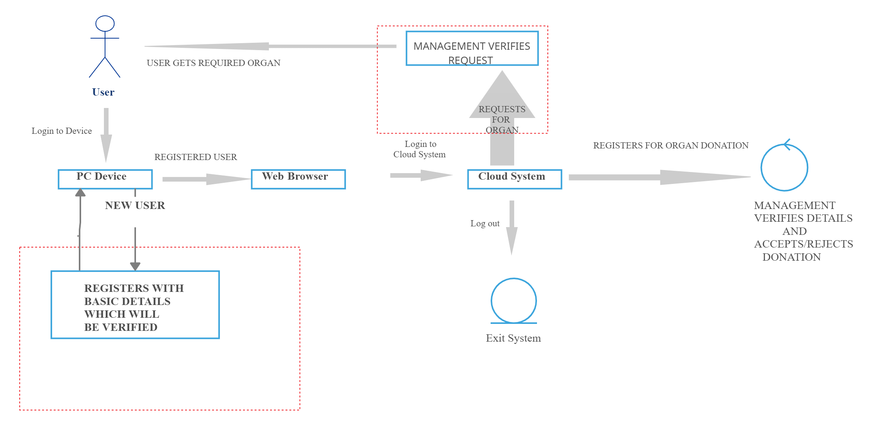
User-Interface diagram

Slide 25
conclusion
At last, we want to host SMART DONOR across the nation so that this initiation can save as many lives as we can who are dying waiting for an organ donation.

Slide 26
references
Campbell, Jennifer (2017). Web Design: Introductory. Cengage Learning. p. 27.
Bureau of Labor Statistics, U.S. Department of Labor. "Information Security Analysts, Web Developers, and Computer Network Architects". Occupational Outlook Handbook, 2012-13 Edition. Retrieved 2013-01-17.

